Slide 1


Southern Cross Institute

Slide 2
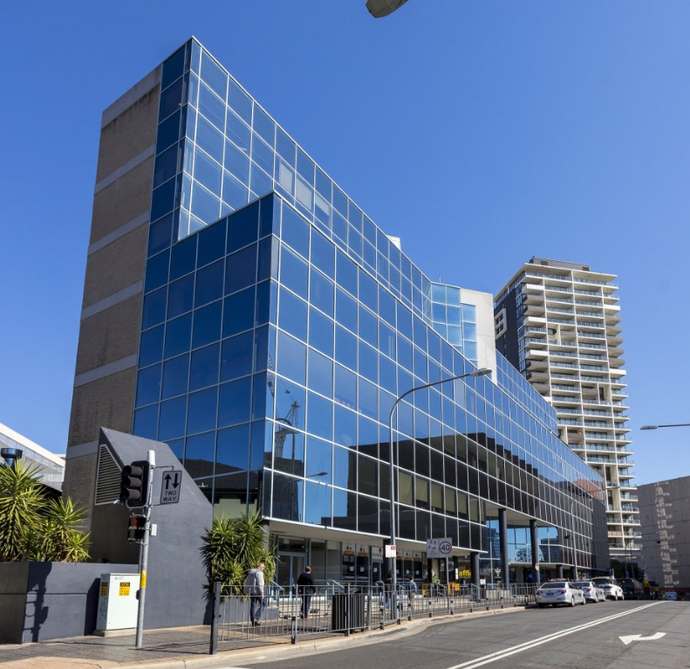
Acknowledgement
SCI acknowledges the Traditional Custodians and Elders of Country throughout Australia, and their connection to land, sea and community.
We specifically acknowledge the Traditional Custodians of the Darug land on which our Institute resides. We pay our respects to Aboriginal and Torres Strait Islander Elders past, present and emerging.
We recognise the continuation of the cultural, spiritual and educational practices of Aboriginal and Torres Strait Islander Peoples

Slide 3


Welcome to
Southern Cross Institute
(SCI)
New Student Orientation
Semester 2, 2026
29 June 2026

Slide 4
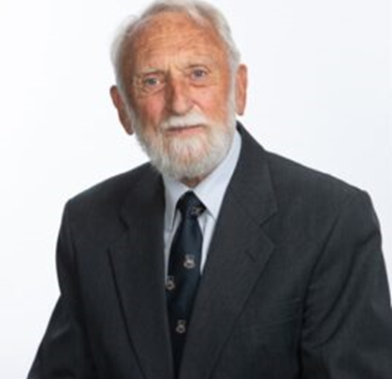
Message
Chair of the Governing Council
A very warm welcome to SCI. We are a dynamic institute offering an innovative and exciting course delivered by enthusiastic, dedicated and highly qualified staff. Education is the most valuable investment that we can make in the quality and success of our own lives and the life and progress of our wider society. Proper education is much more than just information transfer. It provides us with skills in thinking, reasoning, analyzing and evaluating ideas, policies, processes and actions.
Specially designed courses offered at SCI are aimed at providing the basic skills necessary for professional lives after graduation. Such education occurs best when there is personal contact with highly qualified and engaged staff, in company with fellow students and access to relevant experiences. As an SCI graduate, you will emerge as a competent and confident practitioner in your chosen profession, committed to continued learning throughout your career.
Very best wishes for your studies with us.
Professor Brian English,
Chair of the Governing Council

Slide 5
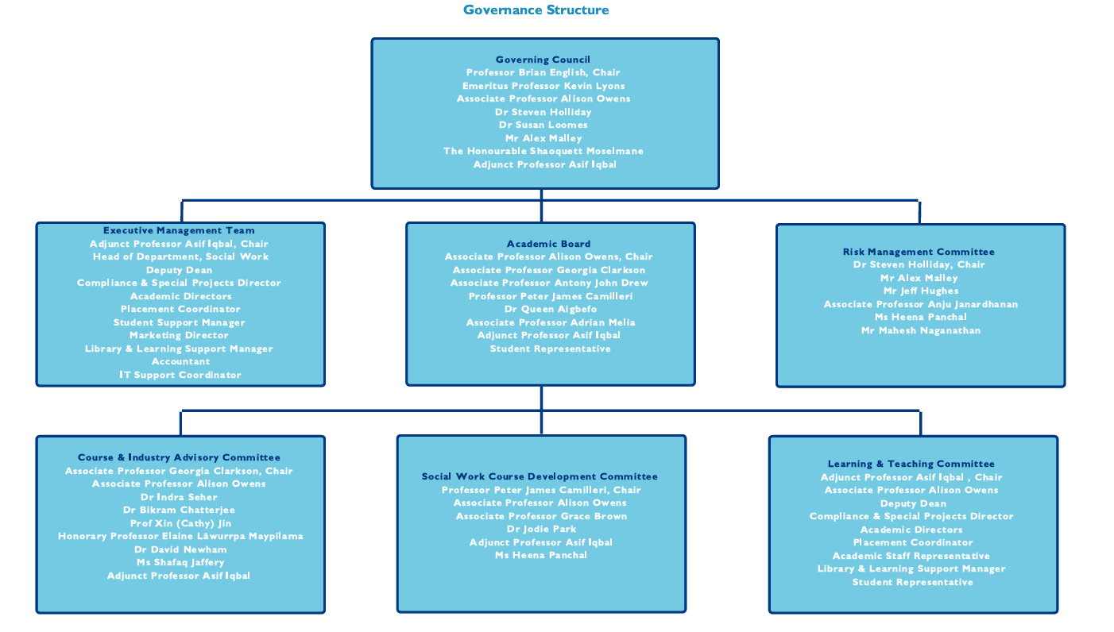

Slide 6
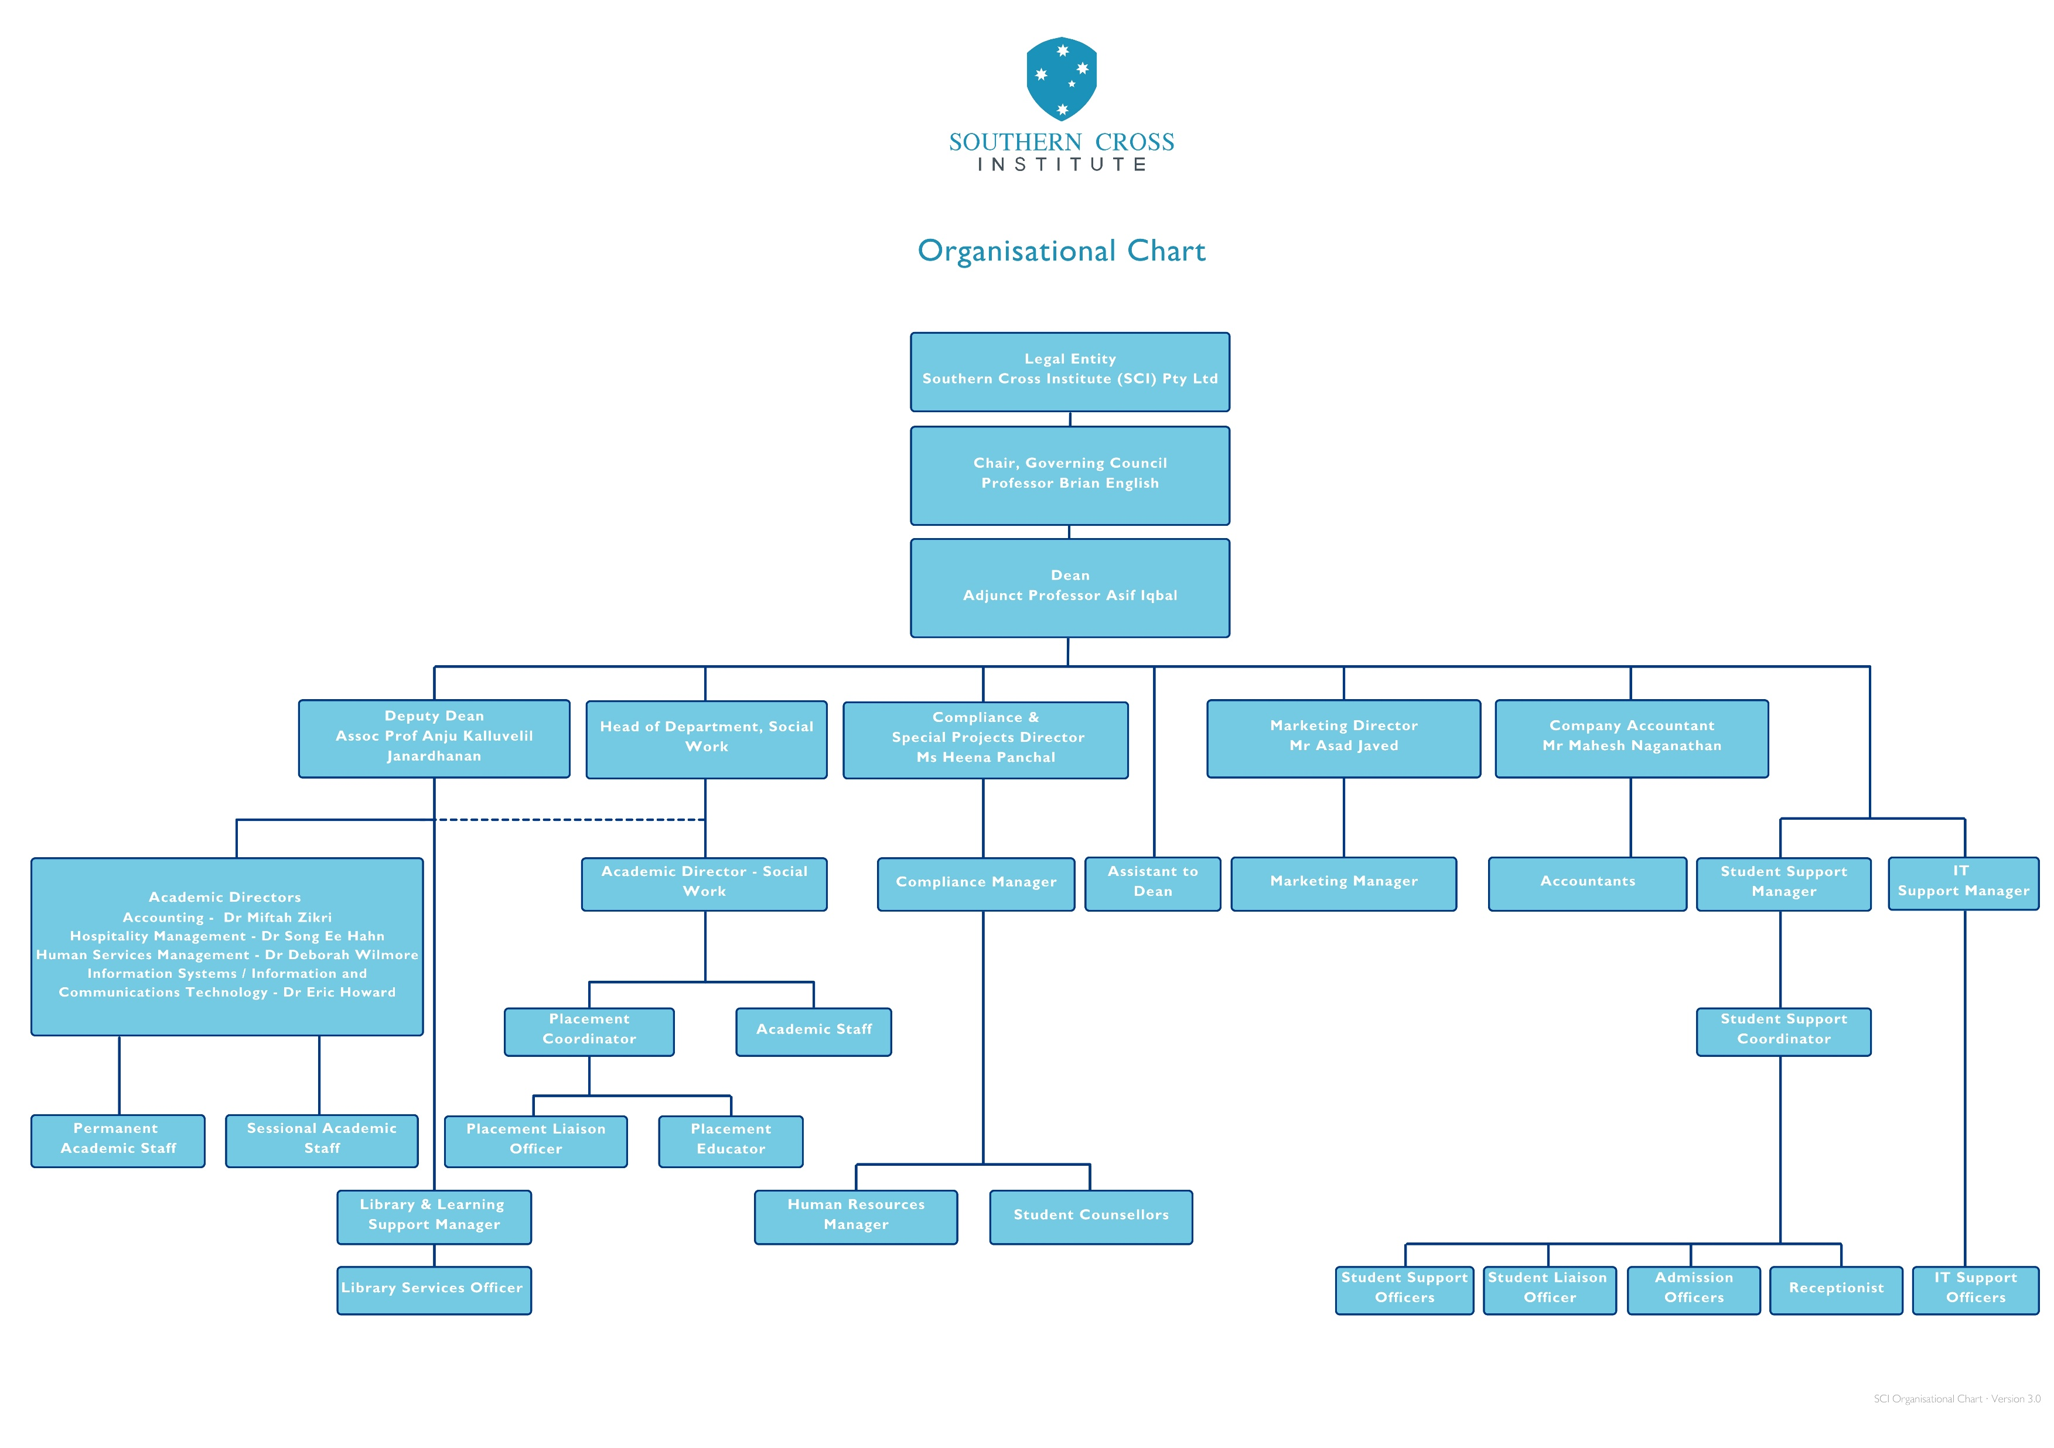

Slide 7
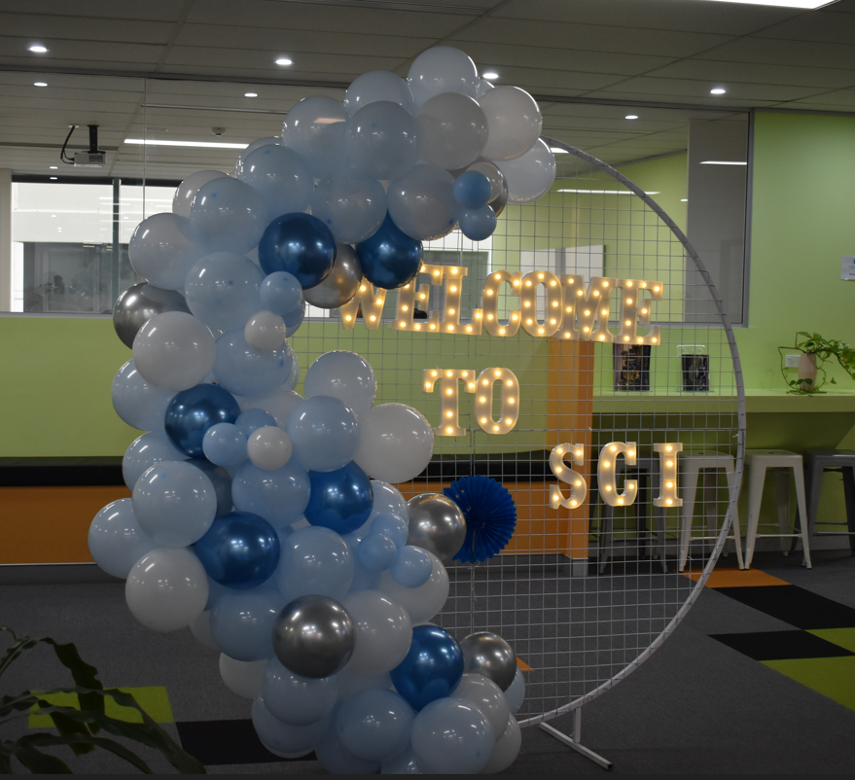
SCI Parramatta Campus
Level 2, 1-3 Fitzwilliam Street,
PARRAMATTA NSW 2150

Slide 8
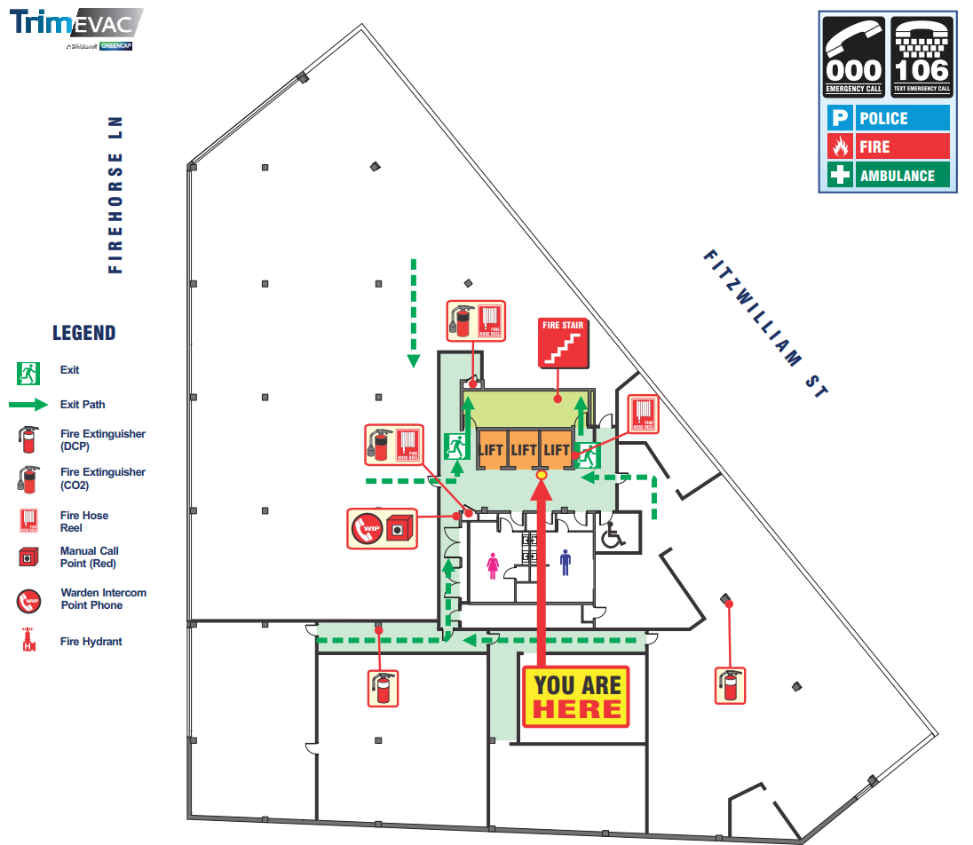
SCI Emergency Evacuation Plan
Level 2, 1-3 Fitzwilliam Street,
PARRAMATTA NSW 2150

Slide 9
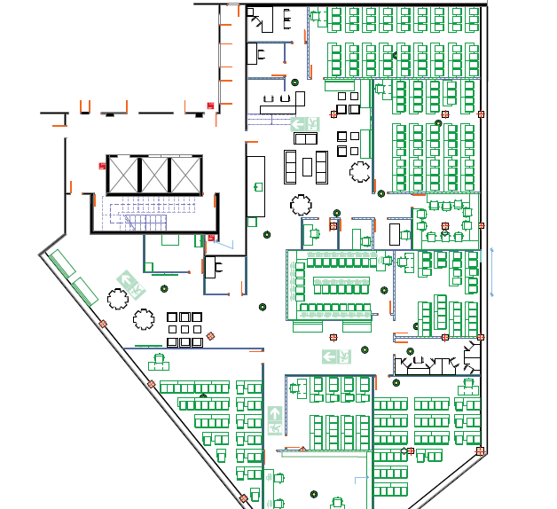
SCI Floor Plan
Level 2, 1-3 Fitzwilliam Street, PARRAMATTA NSW 2150

Slide 10
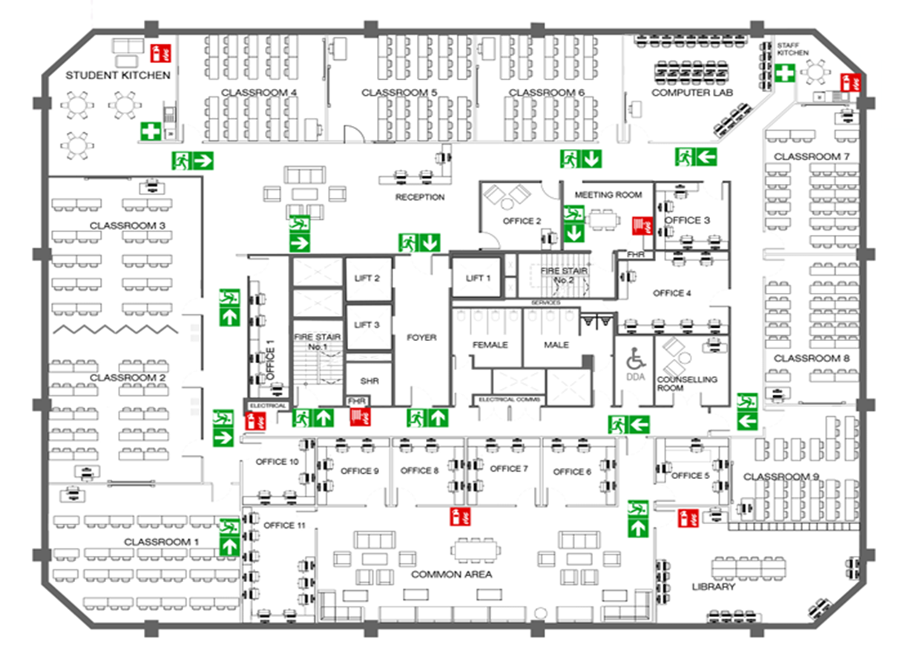
SCI Floor Plan
& Emergency Evacuation Plan
Level 6, 31-39 Macquarie Street, PARRAMATTA NSW 2150

Slide 11

SCI Campus Rules
Smoking is prohibited throughout the building including the foyer, fire exits, toilets, and lifts.
On hearing an evacuation alarm, or on the instructions of emergency control personnel, immediately cease all activity, secure personal valuables, and leave the Campus building. Stay calm, and do not panic.
In a fire, do not use the lift to evacuate the building.
Evacuate the Campus building using the nearest and safest fire exit. Follow the most direct route to the exit.
Move to the closest, assembly area or as directed by staff/emergency services. Remain at the assembly area until the all-clear has been given.
Staff in charge of a class are responsible for an orderly evacuation. Please follow their instructions.

Slide 12

Key Academic Staff
Adj Prof Asif Iqbal
Dean & CEO
Assoc Prof Anju Kalluvelil Janardhanan
Deputy Dean
Dr Song EE Hahn
Academic Director - Hospitality Management
Dr Eric Howard
Academic Director – Information Systems & Information and Communications Technology
Dr Deborah Wilmore
Academic Director – Human Services Management
Dr Miftah Zikri
Academic Director – Accounting

Slide 13
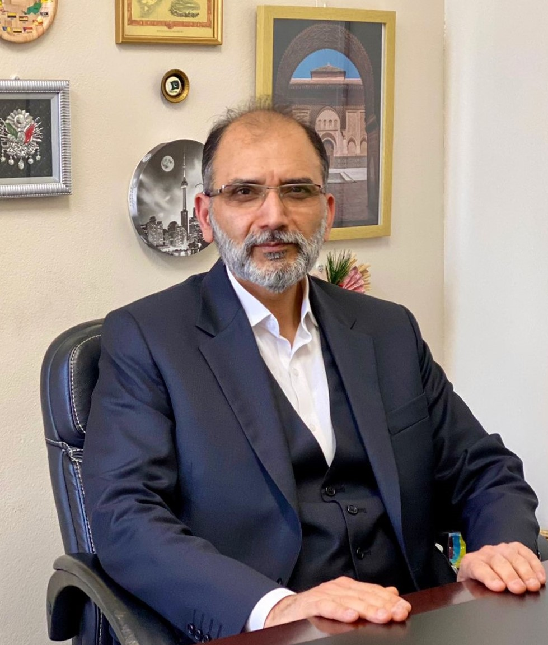
Adj Prof Asif Iqbal
Dean & CEO

Slide 14
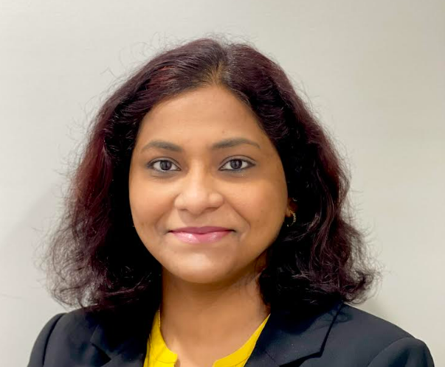
Assoc Prof Anju Kalluvelil Janardhanan
Deputy Dean

Slide 15
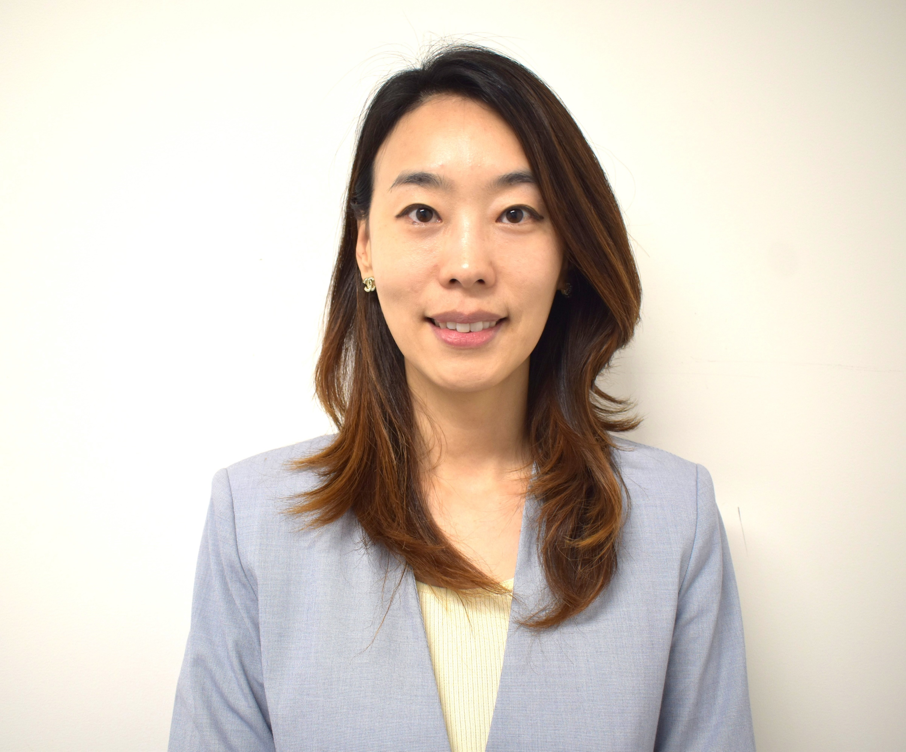
Dr Song EE Hahn
Academic Director,
Hospitality Management

Slide 16
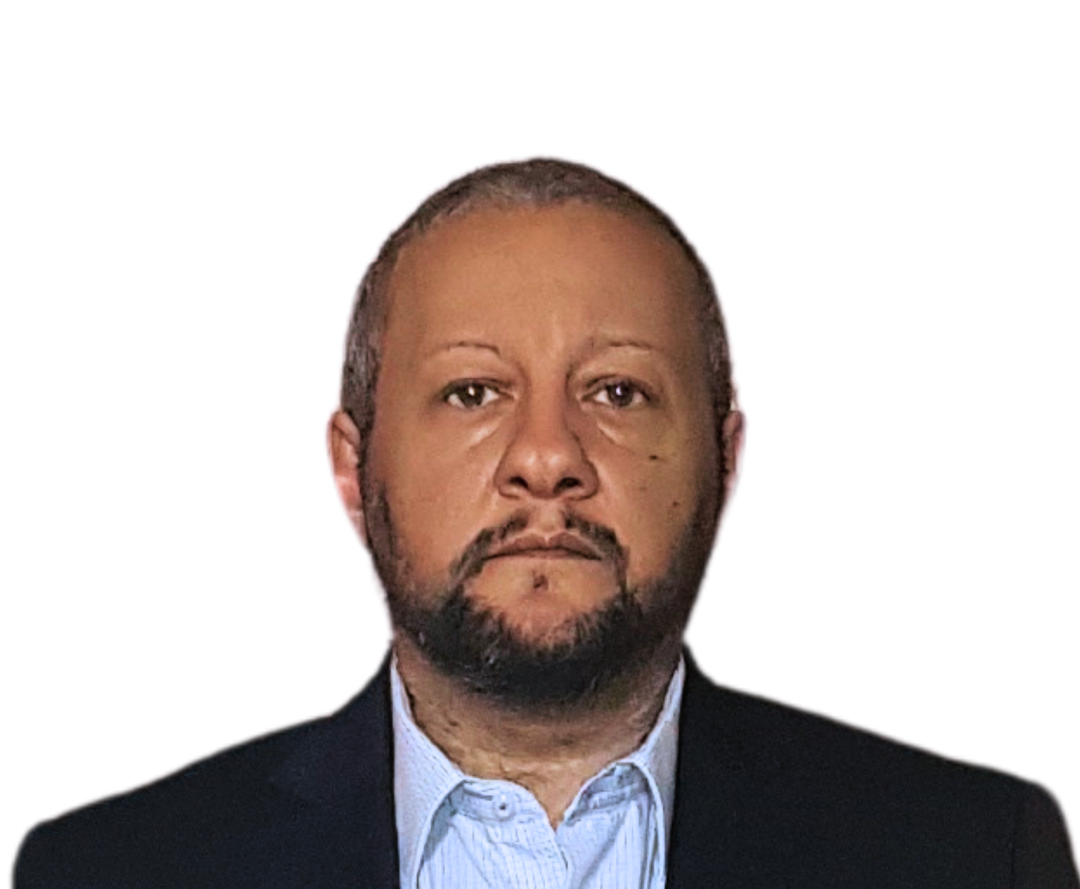
Dr Eric Howard
Academic Director,
Information Systems &
Information and Communications Technology

Slide 17
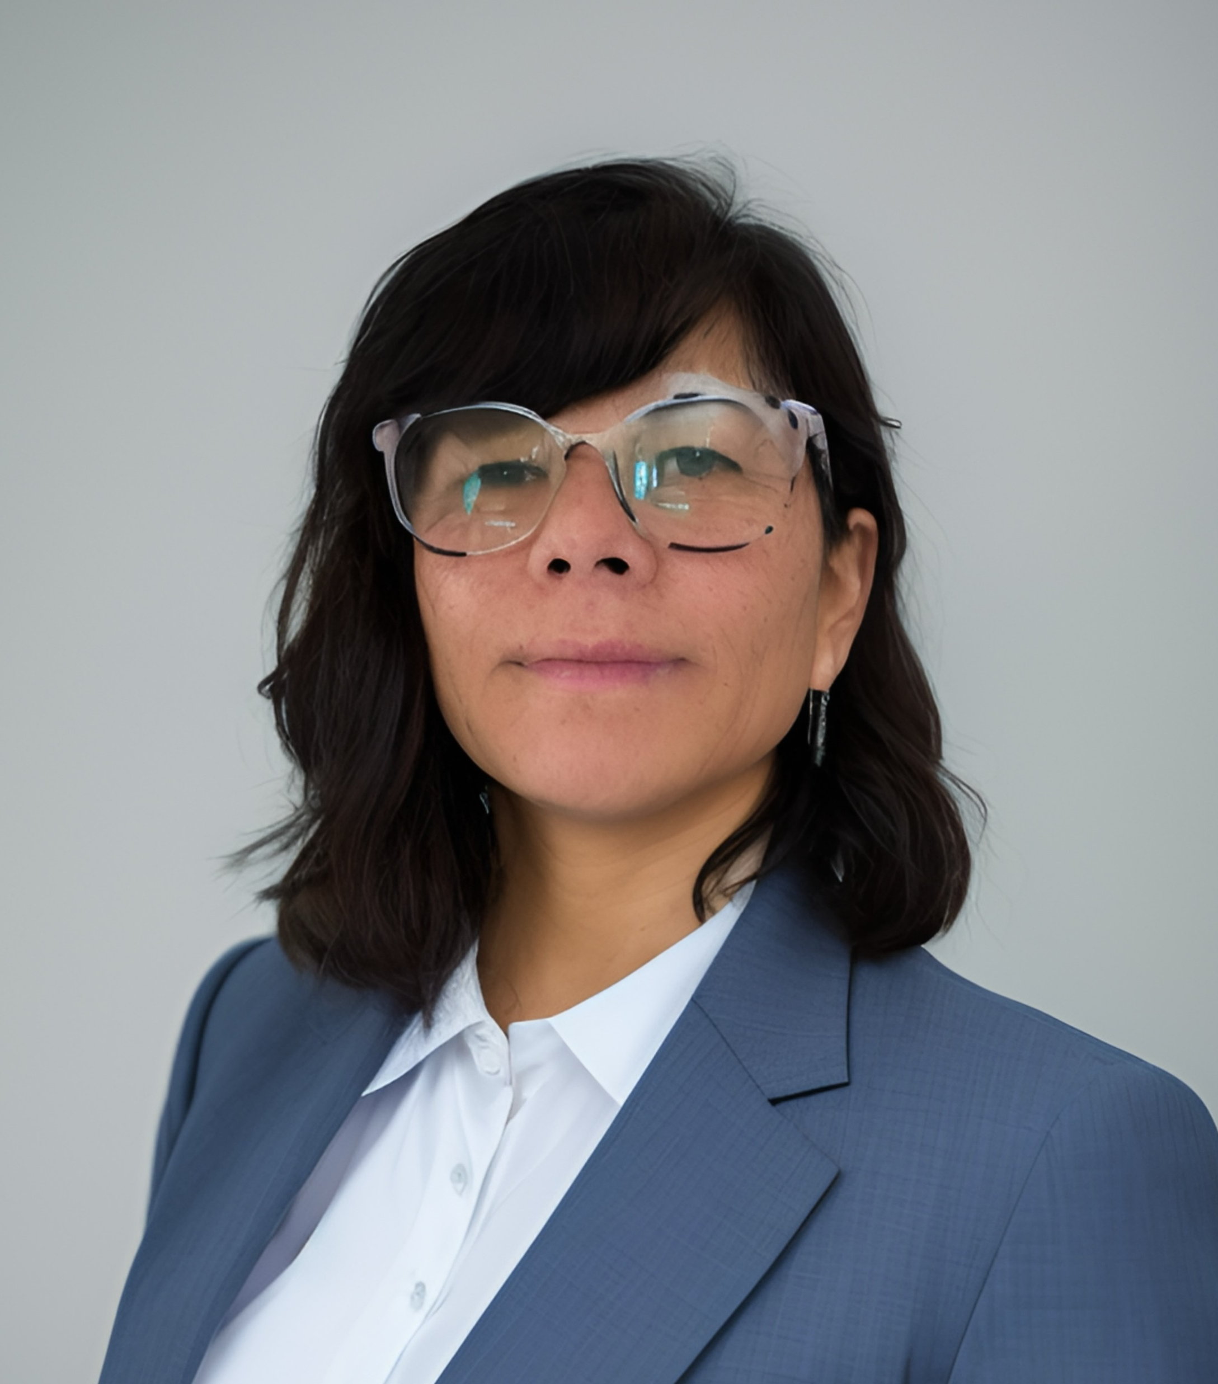
Dr Deborah Wilmore
Academic Director,
Human Services Management

Slide 18
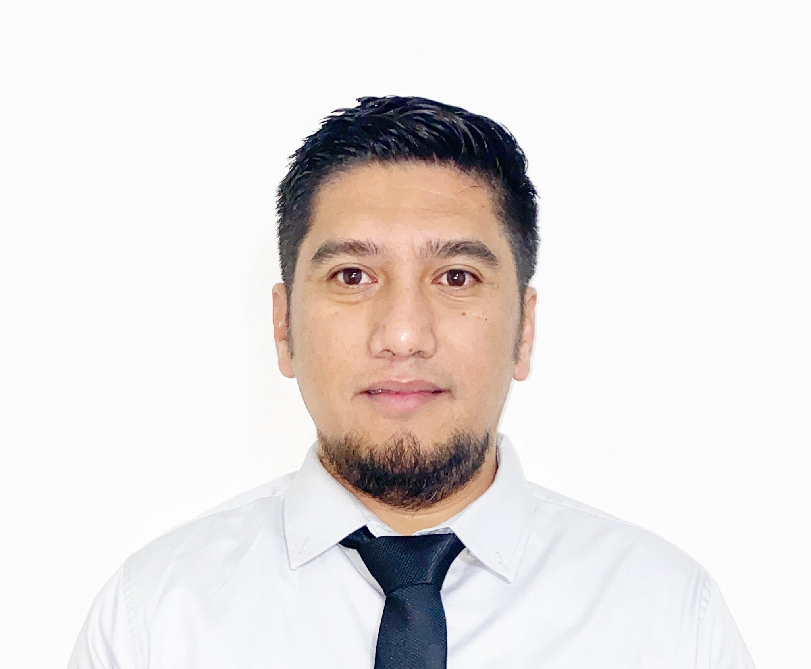
Dr Miftah Zikri
Academic Director - Accounting

Slide 19

Bachelor of Business
Course Structure
SCI Bachelor of Business course has the following delivery structure:
3 years of full-time face-to-face classroom-based teaching delivered over 6 semesters;
Each semester is of 16-weeks duration (1-week orientation + 12-weeks delivery + 1-week study break + 2-weeks exam period);
24 units; 10 credit points (cps) per unit;
240 credit points to complete the program;
Each class includes 4 contact hours per week, divided into lecture and tutorial components (2 hours lecture + 2 hours tutorial);
For each contact hour, 1½ hours of independent study is expected from students for every face-to-face hour (4 + 6 = 10 hours workload per unit per week);
Full-time student workload: 4 units x 10 hours per unit = 40 hours per week.

Slide 20
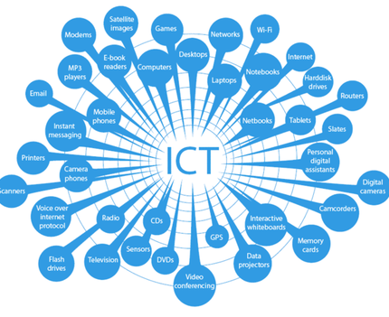
Master of Information and Communications Technology (MICT)
Course Structure
SCI Master of Information and Communications Technology (MICT) course has the following delivery structure:
2 years of full-time face-to-face classroom-based teaching delivered over 4 semesters;
Each semester is of 16-weeks duration (1-week orientation + 12-weeks delivery + 1-week study break + 2-weeks exam period);
16 units; 20 credit points (cps) per unit, except for ICT Capstone Project, which is 40 credit points;
320 credit points to complete the program;
Each class includes 4 contact hours per week, divided into lecture and tutorial components (2 hours lecture + 2 hours tutorial);
For each contact hour, 1½ hours of independent study is expected from students for every face-to-face hour (4 + 6 = 10 hours workload per unit per week);
Full-time student workload: 4 units x 10 hours per unit = 40 hours per week.

Slide 21
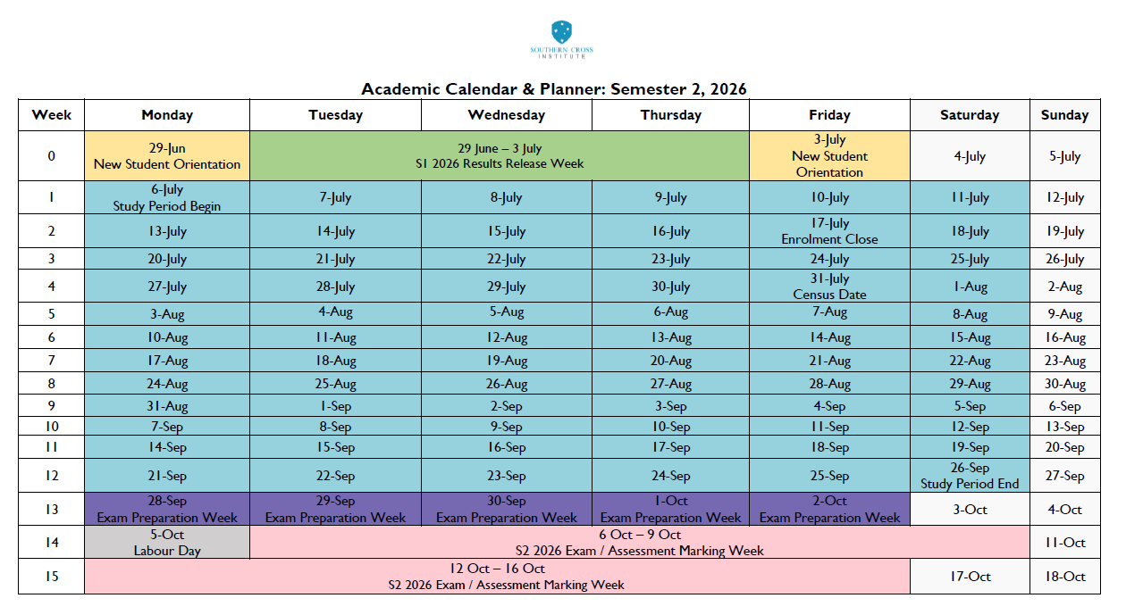
Academic Calendar & Planner – Semester 2, 2026

Slide 22


Student ID Card
SCI Student ID Card is the only official/acceptable form of ID for all students at SCI. It is important for all students to obtain and use their Student ID Card for:
Identification
Entry to exams
Library borrowing
ssc@sci.edu.au

Slide 23

Login
Login to OASIS, or contact Student Support Officer for assistance at sso@sci.edu.au
+61 2 9066 6902
Set up your email
Check your timetable
Login to Meshed to check your timetable, or contact Student Support Officer for assistance at sso@sci.edu.au
+61 2 9066 6902
Login to your student email account and forward your emails to your personal account, or contact Student Support Officer for assistance at sso@sci.edu.au
+61 2 9066 6902
Explore
Explore your OASIS for each course and find your Unit Outline and information about your assessment tasks

Slide 24
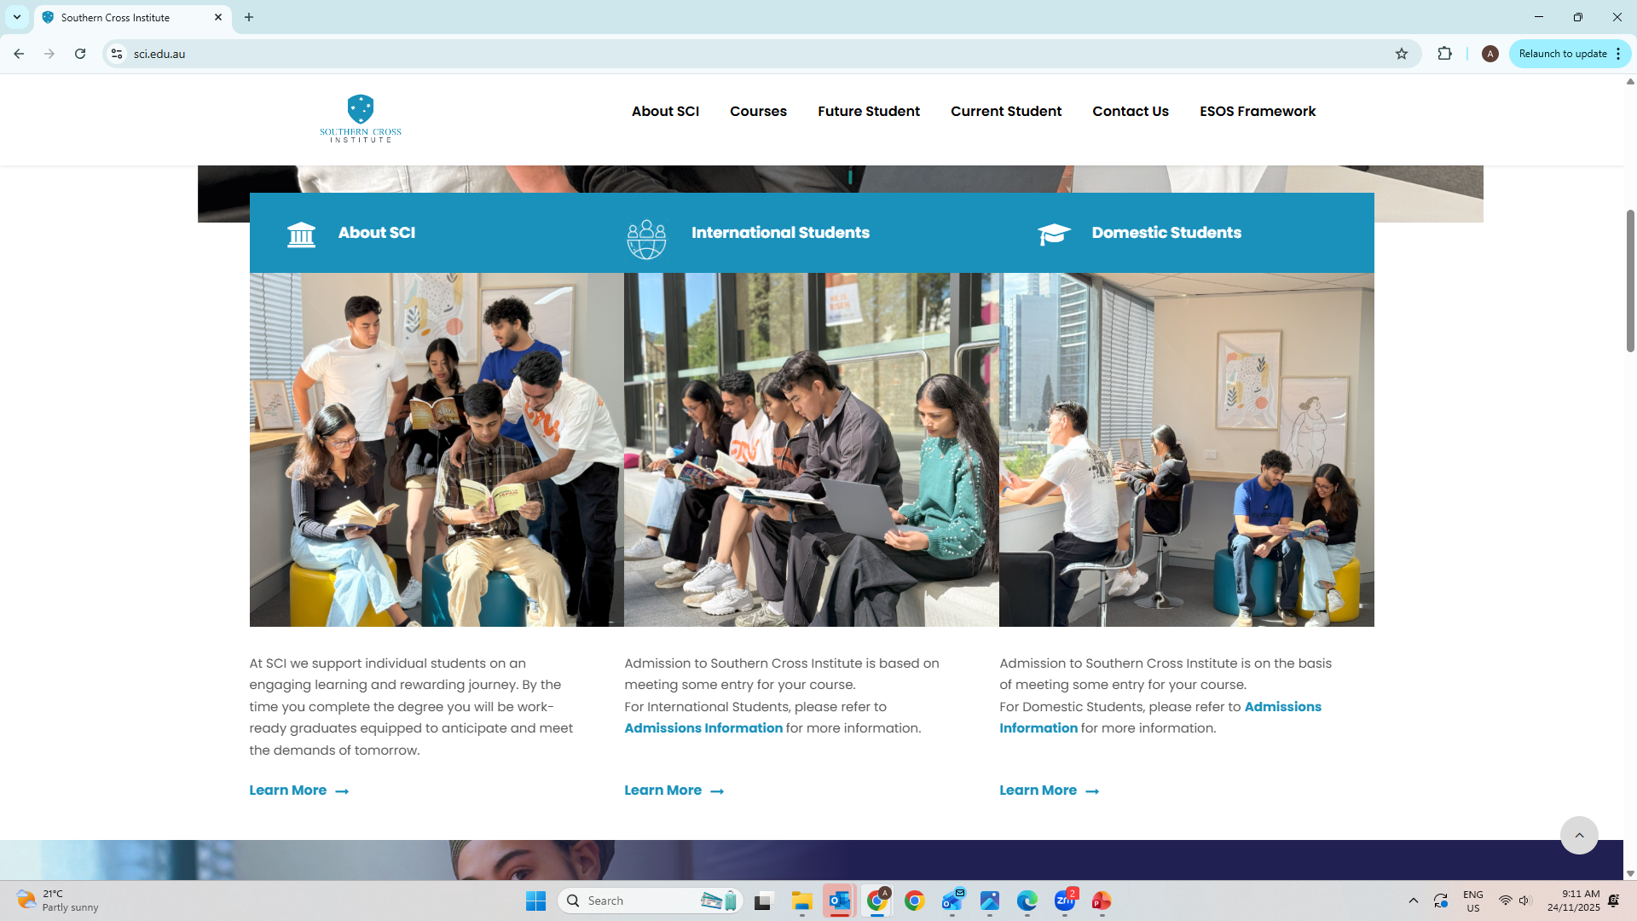
SCI Website – www.sci.edu.au

Slide 25
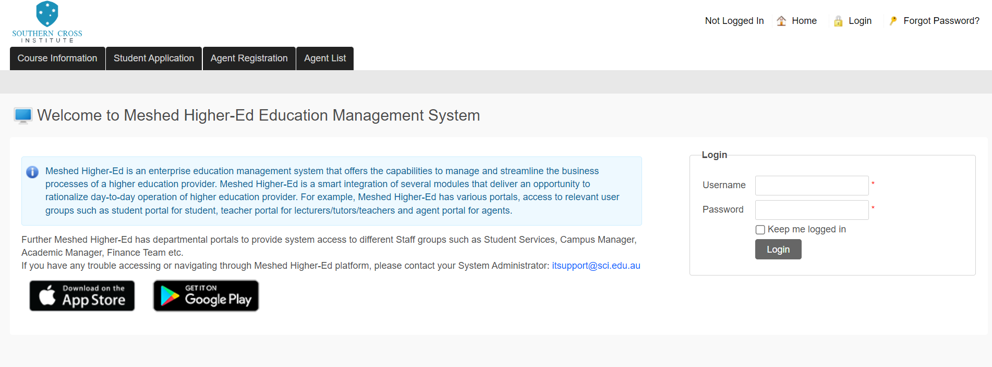
SCI Meshed – Your Online Portal

Slide 26
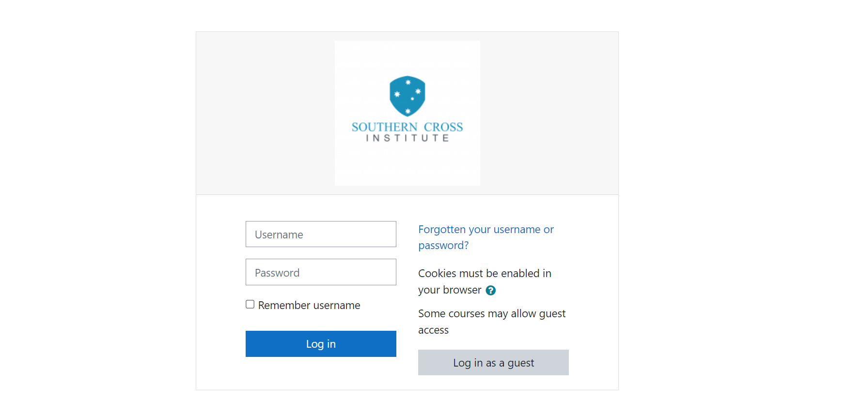
OASIS (eLearning)
Login

Slide 27

Student Support at SCI
To facilitate a positive and successful transition for students and promote their well-being, SCI currently offers the following support services:
Administrative/Academic Support;
Aboriginal and Torres Strait Islander Student Support;
Academic and Career Consultation;
Health and/or Disability Services Support;
Mental Health & wellbeing
Support for ‘At-Risk’ Students;
English Language Support;
Academic Counselling Sessions;
Learning Support Sessions;
For details, please refer to policies on SCI website sci.edu.au

Slide 28
Wellbeing Support
Sexual Harassment and Assault Policy and Procedure
Link – https://sci.edu.au/download/sexual-harassment-policy-and-procedure_v1-1/?wpdmdl=8081&refresh=69854937d2abb1770342711
SCI’s Wellbeing Support – We Hear You!
Link - https://sci.edu.au/wellbeing-support-we-hear-you/

Slide 29

Policies & Procedures

Slide 30

SCI Student Handbook is available on SCI website and at Reception Desk.
www.sci.edu.au
SCI Student Handbook
The handbook contains SCI Policies and Procedures.

Slide 31

Procedure for Claiming Refund
Refund Application
Submit Completed Refund Application Form to
sso@sci.edu.au
If Approved:
Refund Paid Within 20 working days
For Appeals:
See “Student Grievance Management Policy and Procedure”
  If you are not satisfied with the outcome of your refund application, you have a right to appeal that decision in accordance with the Student Grievance Management Policy and Procedure.

Slide 32

Grievance Management Procedure
Formal Grievance Management Procedure
Academic grievances may include:
  matters of academic advancement;
  assessments including examinations and other evaluations;
  course curriculum, and/or;
  awards in a course of study.
Non-academic grievances cover all other matters, including complaints about private information held by the Institute with respect to the student.

Slide 33
Grievance Management Procedure
Formal complaint must be lodged by submitting Student Grievance Application Form;
Investigation commences and the student is notified within five (5) working days of receipt of the form;
Student notified of the outcome within ten (10) working days of grievance being received;
The Institute retains a register of official complaints and grievances and activities made in compliance with the Records Management Policy and Procedure.

Slide 34

Deferral, Suspension and Cancellation
Deferral
Students who wish to defer the commencement date of their course must advise the Institute in writing by completing the Request for Deferral Form. The Form must be accompanied by documentation clearly demonstrating the compassionate or compelling reasons for deferment.
Suspension of Study or Cancellation of Enrolment
The Institution reserves the right to suspend or cancel a student’s enrolment for reasons, including but not limited to academic and non-academic misconduct, non-payment of fees, failure to maintain satisfactory course progress or failure to maintain attendance requirements and breach of academic integrity
For further details, please refer to the Deferral, Suspension and Cancellation Policy and Procedure

Slide 35

Academic Integrity
  SCI takes all cases of academic misconduct seriously. The students and staff are subject to penalties for committing academic misconduct;
  Library & Learning Support Manager is the Academic Conduct Officer who is responsible for identifying and reporting possible academic misconduct activity and educating students about scholarly practice and academic integrity;
  All of academic integrity breaches will be reported and recorded in Academic Misconduct Register;
  Students must complete Academic Integrity module before the start of the Program;

Slide 36

Learning Support Sessions
Odd Weeks
  Even Weeks
Reach out to the Learning Support Office at lso@sci.edu.au and library@sci.edu.au

Slide 37

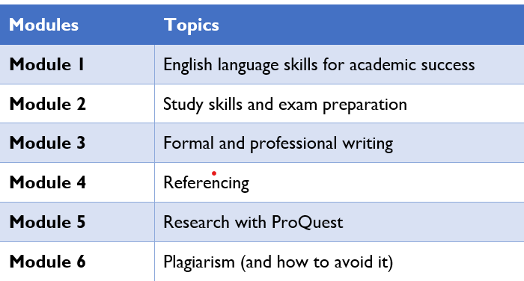
Your Study at SCI Learning Support
SCI provides ongoing and timely additional learning support to students through structured Learning Support Sessions to facilitate further development of learning skills and to improve English language proficiency.

Slide 38


Library
Library & Learning Support
SCI library home and search page can be reached at:
SCI OASIS page can be reached at:
https://southerncross.softlinkhosting.com.au/liberty/libraryHome.do
library@sci.edu.au
lso@sci.edu.au
https://elearning.sci.edu.au/login/

Slide 39
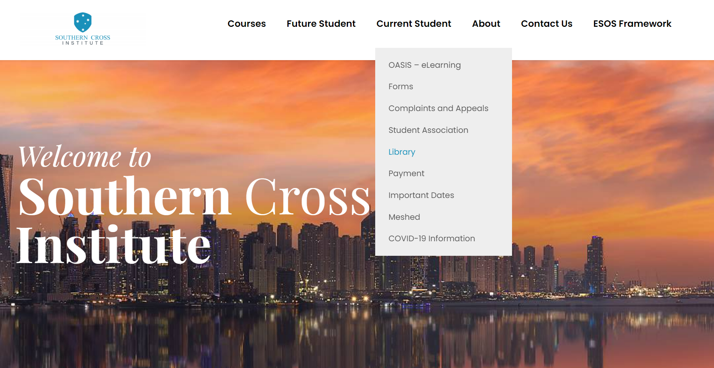
Library
Find the catalogue at https://sci.edu.au/
> Current Students > Library
Browse the collection
Check availability
Renew loans
Access ProQuest
Update library account

Slide 40
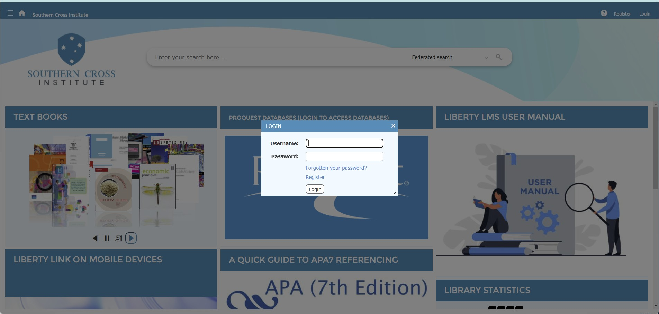
Where to find the catalogue
Library
www.sci.edu.au > Current Students > Library
Search the catalogue
Check availability
Renew loans
Access ProQuest
Update library password

Slide 41

Life in Australia for International Students
Student Visa Restrictions for Student Visa Holders | Accommodation
Tax File Number (TFN) | Overseas Health Cover
https://www.study.nsw.gov.au/ | Transportation in Sydney and wider NSW

Slide 42
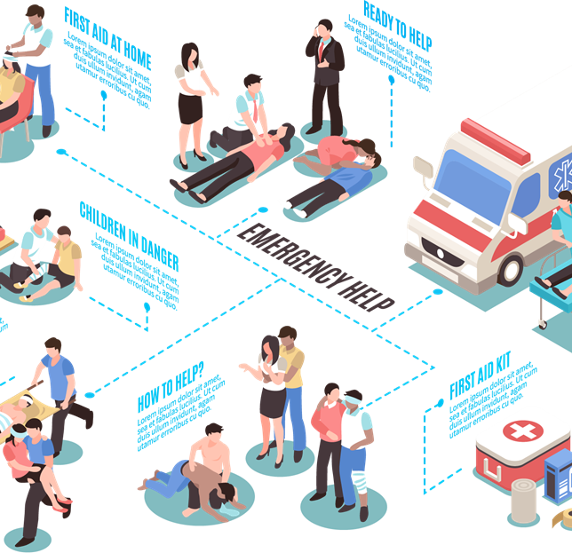
Medical Services
Parramatta Medical Centre Entrada Building,
Shop 2, 20 Victoria Rd In Entrada
Centre Phone: (02) 9762 1041
Business Hours: 8:00 am – 7:00 pm (Mon – Fri) / 9:00 am – 3:30 pm (Sat – Sun)
Argyle Street Medical Centre
Cnr Argyle & Marsden St, Paramatta NSW 2150
Phone: (02) 9893 8733
Business Hours: 8:00 am – 6:30 pm (Mon – Fri) / 9:00 am – 5:00 pm (Sat – Sun)

Slide 43

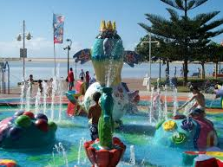
Recreational Activities
Manly Water Works
Cnr West Esplanade & Commonwealth Parade,
MANLY NSW 2095
Luna Park
1 Olympic Drive, Milsons Point NSW 2061

Slide 44
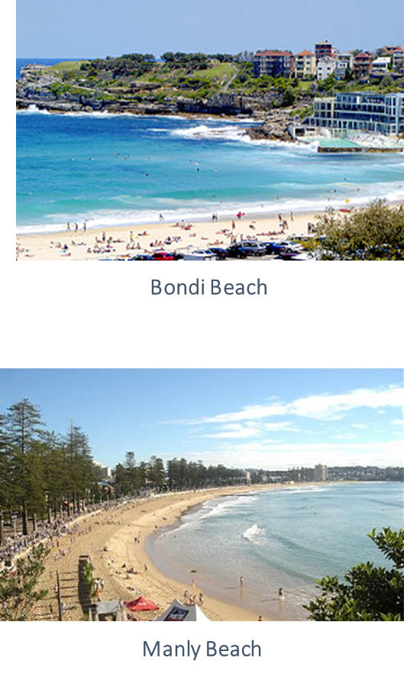
Sydney Beaches
Caution at the Beach
Always swim between the flags.
Do not swim alone.
Be careful of unexpected high waves.
Be careful of leaving personal belongings on the beach.
Always swim in patrolled areas.
Protect yourself from the sun – sunscreen, hat, shirt & sunglasses.

Slide 45
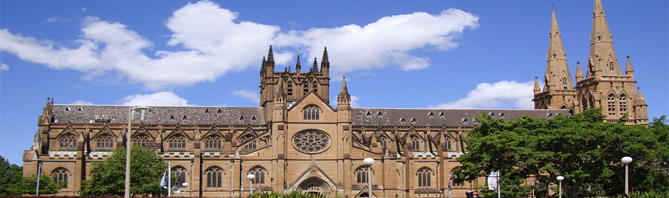
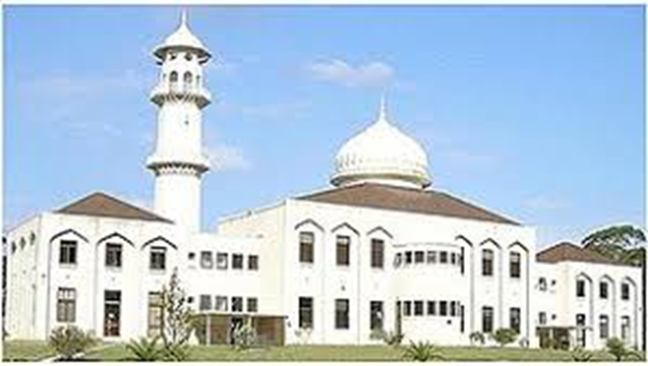
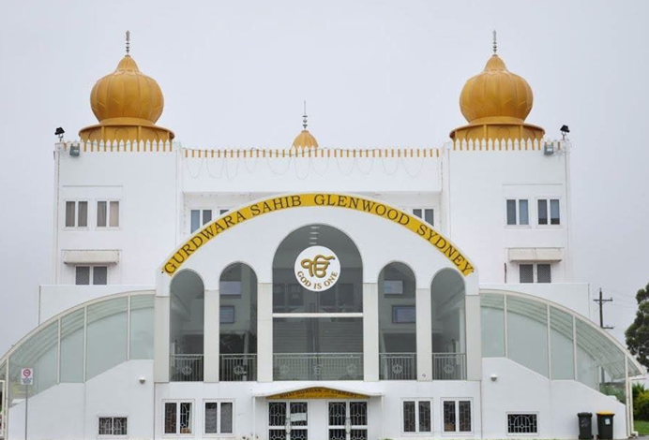


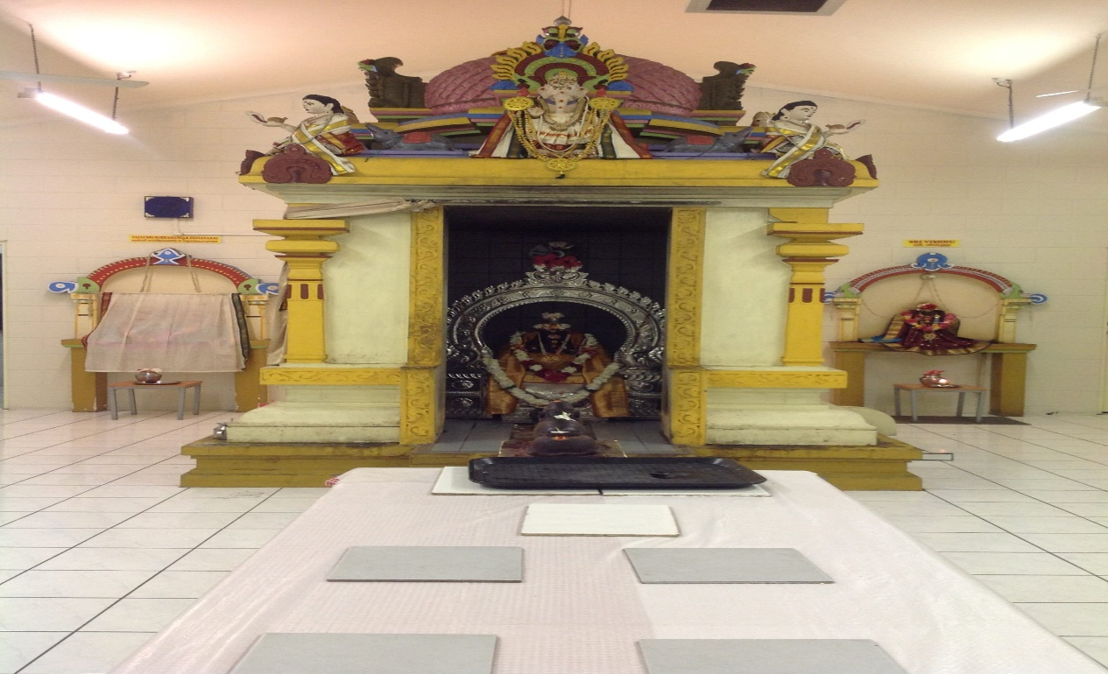
Places of Worship
Australia is a multicultural society where most religions are represented and respected. A listing is available in the SCI Student Handbook and at the Reception for local Churches, other places of worship.

Slide 46

Thank you for choosing to study at SCI

Slide 47







Tel: +61 2 9066 6902 | Email: info@sci.edu.au | Website: www.sci.edu.au
Level 2, 1-3 Fitzwilliam Street, PARRAMATTA NSW 2150 | Level 6, 31-39 Macquarie Street, PARRAMATTA NSW 2150

